Slide 1

Fostering a healthy democracy through support for local journalism
A toolkit for municipal leaders
Ink-stained Wretches 2026

Slide 2
"Without democracy, there will be no independent press, and without an independent press, there can be no democracy.”
Martin Baron, former executive editor, Washington Post Collision of Power

Slide 3
Strengthening democracy by getting:
• informed
• connected
• active

Slide 4
GETTING INFORMED

Slide 5
CLOSED:
605 local news outlets
in 388 communities across Canada*
Local News Research Project 2008 - December 2025
*See the report for data on mergers; news outlets that have launched and closed (156); and outlets that have launched and survived (264).

Slide 6
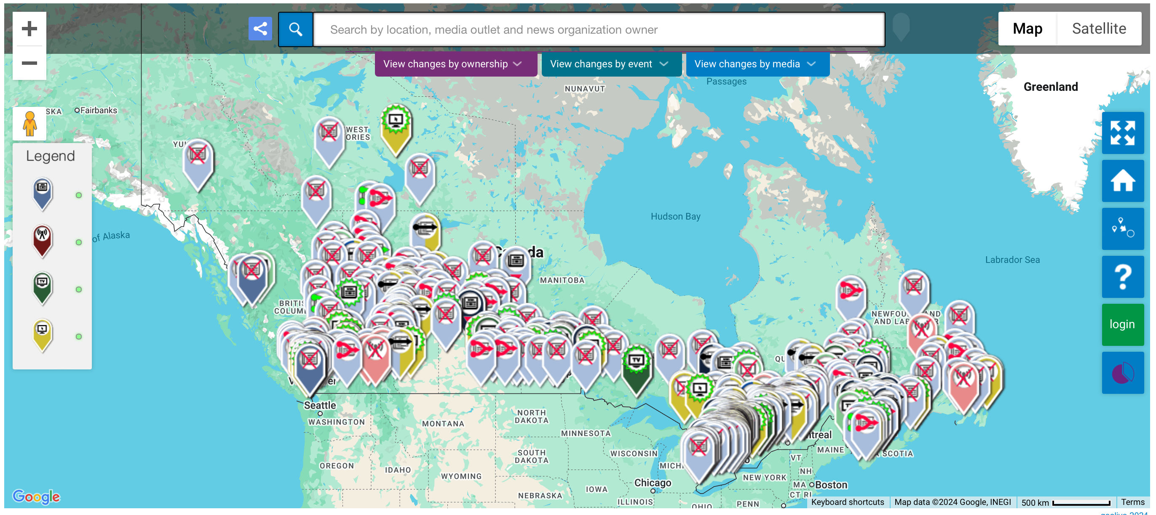
Local News Research Project interactive map

Slide 7
surviving newsrooms
have been severely depleted

Slide 8

“Public access to quality information allows citizens to exercise their rights, hold their governments to account and make more informed decisions about their lives.” (Towards the Localization of the SDGs, p.107)

Slide 9
GETTING CONNECTED

Slide 10
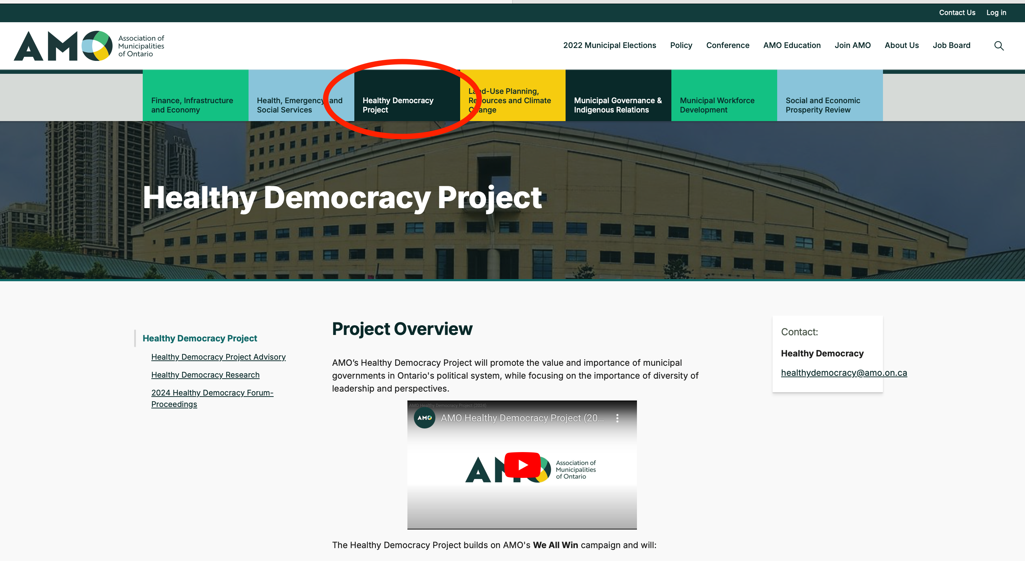
Explore the AMO’s
Healthy Democracy Project

Slide 11
GETTING ACTIVE

Slide 12
Consider taking some of the following
16 actions

Slide 13
1. Join the dozens of Canadian municipalities that have already passed council motions expressing vocal support for local journalism.
See details and draft wording here.

Slide 14

  2. Add UN World Press Freedom Day (May 3rd) to the calendar of commemorative days your municipality acknowledges and participate in the global #SpotlightPressFreedom Campaign by:
• lighting municipal infrastructure
• issuing a proclamation
• raising the UN flag
spotlightpressfreedom.org

Slide 15
3. In addition to acknowledging World Press Freedom Day publicly, promote it to staff via your intranet.

Slide 16
4. Consider following the Ontario government’s lead by
adopting its 2024 directive to Crown corporations and government agencies to spend at least 25% of advertising budgets with Ontario-based news outlets.

Slide 17
5. Suspend paid advertising on Facebook and other Meta platforms
— continue to post for free only —
in response to Meta’s decision to block news in Canada.

Slide 18
When public funds are spent to advertise with
U.S.-based platforms:
money leaves the community.
it strengthens corporations that have decimated — and continue to fight — one of the bedrocks of a healthy democracy.
it’s unclear whether it increases, to any appreciable extent, citizen participation above organic posts.

Slide 19
In 2023, the following civic institutions suspended paid advertising
in support of the Online News Act.*
*Note: It’s unclear how many remain in effect.
Hamilton
Montreal, Quebec City, Longueuil, Laval, Gatineau
Province of Quebec
Government of Canada
Quebec politicians, media companies vow to stop advertising on Facebook

Slide 20
6. On your municipality’s website, post links to trusted sources of local news.

Slide 21
7. During onboarding for councillors and staff, include a ‘healthy democracy’ module.
Make sure the module highlights the news media’s role in ensuring a healthy democracy and the precarious state of local journalism.

Slide 22
8. Enhance media coaching for managers.
Make sure coaching highlights the news media’s role in ensuring a healthy democracy and the precarious state of local journalism.
Invite newsroom managers to help create your crisis communications plan.
Make your content (photos, videos and audio) easily available to local news media.

Slide 23
9. Enhance staff training on privacy legislation by including a module on local journalism’s role in ensuring transparency and enhancing trust in government.
Also include a segment on the precarious state of local journalism.

Slide 24
10. Explore online subscription deals for all staff.

Slide 25
11. Arrange for newspapers to be delivered to staff areas in all municipal facilities including City Hall; community centres; fire halls; police stations; swimming pools, ice rinks and more.

Slide 26
12. Allow local newspapers to place newspaper racks in your public spaces including pools, arenas and community centres.

Slide 27
13. Mobilize library systems
Contact us if your municipality’s librarians would like to participate in creating a toolkit for librarians

Slide 28

14. Explore and share the Local Democracy Solutions Bank
created by the Association of Municipalities of Ontario’s
Healthy Democracy Project and
the Democratic Engagement Exchange at Toronto Metropolitan University

Slide 29
15. On your municipality’s local democracy web page, post a link to the Ink-stained Wretches’ resources page, which includes a reading list and much more.

Slide 30
16. Share your ideas for this toolkit!
Send them to Mirko Petricevic at
ink.stained.campaign@gmail.com

Slide 31
Toolkit roundup
1. Consider joining the dozens of municipal councils that have already passed motions expressing support for local journalism.
2. Add UN World Press Freedom Day to your calendar of observances. Participate in the #SpotlightPressFreedom campaign.
3. Promote World Press Freedom Day to staff via your municipality’s intranet.
4. Consider following the Ontario government’s lead by adopting its directive to Crown corporations and government agencies to spend at least 25% of advertising budgets with publishers based in the province.
5. Suspend paid advertising on Meta platforms — post for free only — as a response to its news block in Canada.
6. On municipal web pages, post links to trusted sources of local news.
7. During onboarding for staff and councillors, include a ‘healthy democracy’ module.
8. Enhance media coaching for managers by highlighting the precarious state of local journalism.
9. Enhance information privacy training by adding a module on the importance and precarious state of local journalism.
10. Explore online subscription deals for all staff.
11. Deliver newspapers to staff areas in all municipal buildings.
12. Allow newspaper racks in public-access municipal buildings.
13. Mobilize library systems.
14. Explore and share the Local Democracy Solutions Bank.
15. On your municipality’s local democracy web page, post a link to the Ink-stained Wretches’ resources page.
16. Send your suggestions to ink.stained.campaign@gmail.com

Slide 32
This resource — Fostering a healthy democracy through support for local journalism: A toolkit for municipal leaders —
was produced by Ink-stained Wretches in partnership with
the Local News Research Project.

Slide 33


